Slide 1
Neural Network Models for Object Recognition
Model Architecture, Evaluation, and Learnings Presentation
by PP24589

Slide 2
Contents
Introduction
Data Description and Preprocessing
Data Partitioning and Dataset Metadata
Training Strategy and Optimization Choices
Chosen Activation Function
Neural Network Strategy
Results Analysis
Model Accuracy and Model Loss
Validation and Training Loss gap analysis
Confusion Matrix Evaluation
Model Predictions – Visual Examples
Reflections and Lessons Learned
References and Python Code

Slide 3
1. Introduction
The application of Artificial Intelligence (AI) is increasingly important across global industries, revolutionizing areas from transport to surveillance.
A key application of AI is in object recognition, a critical technology in:
Autonomous vehicles (e.g. pedestrian detection)
Facial recognition systems (e.g. Apple Face ID)
Surveillance and security (e.g. movement tracking, crowd counting)
This project centres on the development of a Convolutional Neural Network (CNN) for object classification using the CIFAR-10 dataset available via Kaggle.
The objective of this project is the designing, training and implementing a CNN by:
Preprocessing the training dataset and systematically partitioning it to create a robust validation set
Training the CNN model and evaluating its performance using the:
Accuracy curves (training and validation)
Loss functions
A detailed confusion matrix to assess the effectiveness of the predictions made
Key areas in the model development are the:
Preprocessing the data and creating a validation set that ensures reliable evaluation
Selecting the appropriate activation and loss functions to optimise the model learning and performance
Designing the network architecture and configuring the required hyperparameters (e.g. learning rate, batch size)
Implementing training strategies that include data augmentation and regularisation methods to prevent overfitting
Analysing the results through visualisations and metrics
Drawing meaningful conclusions from the model’s learning behaviour
1

Slide 4
2. Data Description and Preprocessing
CIFAR-10 Dataset Summary
The CIFAR-10 dataset is widely used for evaluating machine learning models, particularly in the field of image classification.
It consists of 60,000 32x32 color images distributed evenly across 10 categories, with 6,000 images per class.
The categories include: airplane, automobile, bird, cat, deer, dog, frog, horse, ship and truck.
The dataset is balanced and designed to support small experiments, yet complex enough to evaluate model generalization.
Dataset Breakdown
Training Set: 50,000 images
Validation Set: 5,000 images (10% split from training data)
Test Set: 10,000 images
Image Dimensions: 32x32 pixels x 3 color channels (RGB)
Class Labels: airplane, automobile, bird, cat, deer, dog, frog, horse, ship, truck
Preprocessing
Normalisation:
Pixel values scaled to [0, 1] by dividing by 255.
That ensures consistent input range across all color channels, prevents gradient dominance by larger pixels during training and improves the model’s training stability and convergence.
One-hot Encoding of Labels:
Convert integer class labels into binary vectors (it tells which class is correct without using numbers that suggest ranking)
Each vector has a 1 at the index of the correct class and 0 elsewhere.
It is required for the loss function ‘categorical crossentropy’ used in the multi-classification. It measures the difference between the predicted probability distribution and the true class label.
2

Slide 5
2. Data Description and Preprocessing
Preprocessing
Validation Split:
10% of training data held out using ‘sklearn.model_selection.train.test.split’ with fixed random seed to ensure reproducibility.
Reproducible results are important for fair performance comparisons, debugging and validation.
Data Augmentation:
To boost generalization and simulate real-world variability, the model was trained using augmented data.
The `ImageDataGenerator` by Keras, applies real-time random transformations vector such as:
Rotation (up to 15 degrees)
Horizontal flips
Width and height shifts (10%)
Zoom (10%)
These transformations allow to varied perspectives of the same class, reducing reliance on specific orientations or features.
Rationale for Preprocessing
Ensures the uniform input scaling and mitigates gradient dominance.
One-hot encoding enables multi-class probability outputs.
Validation set aids in monitoring generalization and preventing overfitting.
Augmentation improves model robustness to real-world image variability.
3

Slide 6
3. Data Partitioning and Dataset Metadata
Partitioning Method – CIFAR-10 Dataset
The CIFAR-10 dataset was loaded using TensorFlow’s ‘keras.datasets’ API: from ‘tensorflow.keras.datasets’ import cifar10
Initial dataset structure: 50,000 images for training, 10,000 images for testing.
Validation Set Creation
Used Scikit-learn’s train_test_split() to split 10% of training data for validation:
from sklearn.model_selection import train_test_split
Test_size = 0.1 -> 5,000 validation images
Random_state = 42 ensures reproducibility of the split
Final Partitioning:
- 45,000 images for training
5,000images for validation
10,000 images for testing
Purpose of the Validation Set:
The ‘random_state’ ensures reproducibility in the dataset split
Monitors the model performance during training
Guides hyperparameter tuning and detects overfitting
Adaptive learning using ‘ReduceLROnPlateau’
This is Keras callback that monitors the validation loss
Applies stop improving for a defined number of epochs (patience)
Enables finer updates to weights in training
Improves convergence by escaping plateaus and prevents overshooting
Feature | Description
Dataset | CIFAR-10 (Canadian Institute for Advanced Research)
Image size | 32x32 pixels, RGB
Total images | 60,000
Training images | 45,000 (after 10% split)
Validation images | 5,000
Test images | 10,000
Classes | 10 categories: airplane, automobile, bird, cat, deer, dog, frog, horse, ship, truck
Color channels | 3 (Red, Green, Blue)
Format | NumPy arrays, normalized to range [0, 1]
Label encoding | One-hot encoded using keras.utils.to_categorical
4

Slide 7
4. Training Strategy and Optimization Choices
Model Training Strategy – Key Components
Adam (Adaptive Moment) Optimiser:
This is an Adaptive Optimiser that combines AdaGrad and RMSProp
The AdaGrad (Adaptive Gradient Algorith), adapts the learning rate for each parameter based on past gradients
The RMSProp fixes the AdaGrad decay by using exponentially weighted moving average of square gradients.
RMSProp keeps learning rates stable and effective throughout training
# Compile the model with Adam optimizer
model.compile(
optimizer='adam', loss='categorical_crossentropy', metrics=['accuracy'])
Number of Epochs:
50 Epochs are applied. Each epoch represents a full cycle through the training dataset where weights get updated based on errors calculated from predictions.
In each epoch, the model adjusts its internal weights based on the training data to improve predictions
Model weights optimized by minimizing the loss function across epochs.
Each update step within an epoch is governed by backpropagation and gradient decent.
Training across multiple epochs allows weights to converge to values that minimize the loss function.
Why 50 Epochs? this is a practical midpoint that allows the model to:
Learn underlying patterns in the CIFAR-10 dataset
Avoid excessive training time
Rely on callbacks like EarlyStopping to stop earlier if needed
history = model.fit(
datagen.flow(x_train, y_train, batch_size=64), # Generates batches of augmented image data (64 at a time) for training
epochs=50, # Number of full passes over the training data
validation_data=(x_val, y_val), # Validation set used to evaluate model performance after each epoch
callbacks=callbacks, # Includes EarlyStopping and ReduceLROnPlateau to optimize training
verbose=1 ) # Displays training progress in the console (1 = progress bar output)
5

Slide 8
4. Training Strategy and Optimization Choices
ImageDataGenerator for Augmentation:
The model uses ‘ImageDataGenerator’ from Keras to apply real time data augmentation to increase diversity of the training data and reduce model’s reliance on specific positions of objects.
It includes: Rotation, Horizontal Flipping, Width & Height shifting and Zooming
# Data Augmentation Python code
datagen = ImageDataGenerator(
rotation_range=15,
horizontal_flip=True,
width_shift_range=0.1,
height_shift_range=0.1,
zoom_range=0.1
)
datagen.fit(x_train)
Callbacks for Training Control:
EarlyStopping is a Keras callback that monitors the model performance during training
It stops training when the models is stops improving (usually on validation loss)
In Python is:
EarlyStopping(monitor='val_loss', patience=5, restore_best_weights=True),
#where
monitor = ‘val_loss’ to track validation loss
patience=5 how many epochs to wait for improvement before stopping
restore_best_weights=True to revert best model weights
6

Slide 9
5. Chosen Activation Function
The primary activation function used is ReLU (Rectified Linear Unit)
ReLU is defined as f(x) = max(0, x) and introduces non-linearity into the model while being computationally efficient.
Advantages of using ReLU include:
Avoids vanishing gradient problem common in sigmoid/tanh
Faster convergence during training
Softmax Activation for Output Layer
It transforms raw scores into probabilities across the 10 classes with the sum of all output values equals 1
# Initialize a sequential model
model = Sequential([
# First convolutional layer Applies 32 filters of size 3x3 to the input image 'relu' adds non-linearity to the model
Conv2D(32, (3, 3), activation='relu', input_shape=(32, 32, 3)),
# Normalize the activations of the previous layer to speed up training
BatchNormalization(),
# Downsamples the feature maps using 2x2 pooling
MaxPooling2D(pool_size=(2, 2)),
# Randomly drops 30% of the neurons during training to prevent overfitting
Dropout(0.3),
# Second convolutional layer extracts higher-level features with 64 filters
Conv2D(64, (3, 3), activation='relu’),
# Normalize activations again for improved convergence
BatchNormalization(),
# Second pooling layer to further reduce spatial dimensions
MaxPooling2D(pool_size=(2, 2)),
# Another dropout to enhance regularization
Dropout(0.3),
# Flatten the 2D feature maps into a 1D vector for the fully connected layers
Flatten(),
# Fully connected (dense) layer with 128 neurons and ReLU activation, L2 regularization penalizes large weights to prevent overfitting the value 0.001 control its strength
Dense(128, activation='relu', kernel_regularizer=tf.keras.regularizers.l2(0.001)),
BatchNormalization(),
# Dropout 50% of neurons—strong regularization at deeper layer
Dropout(0.5),
# Output layer with 10 neurons (one per CIFAR-10 class), Softmax converts logits into probabilities
Dense(10, activation='softmax’) ])
7

Slide 10
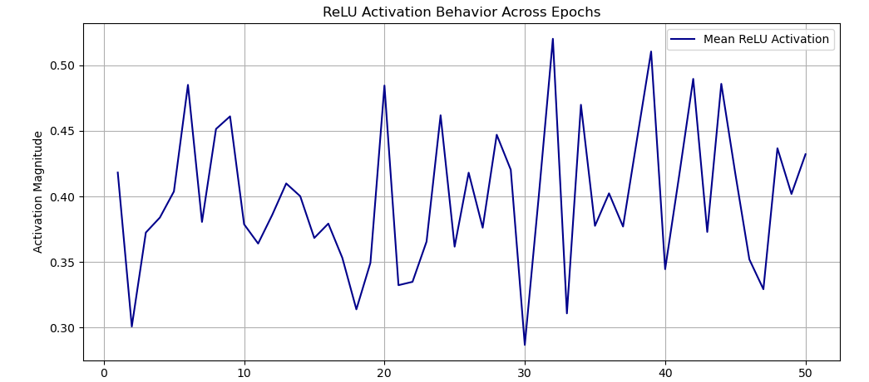
5. Chosen Activation Function
ReLU Activation Behavior
The graph shows the average output of ReLU units changes as the training progresses.
The values stay mostly in the 0.3 to 0.5 range, showing that neurons remain active and engaged - healthy learning behavior.
Ongoing variation suggests complex feature learning. The spikes and drops in activation indicate the network is continually adjusting.
Variability may stem from data augmentation (via ImageDataGenerator), which introduces new input variations in each epoch.
No evidence of dead neurons. ReLU activations remain positive and non-zero, meaning the neurons are firing and contributing to learning.
Minor peaks and dips are expected due to batch variation and data augmentation, which expose the model to different image variations each epoch.
No Saturation Detected. The absence of extremely low or high activation magnitudes (close to 0 or >0.9) shows that the model maintains a balanced learning state, not overly biased toward specific features.
The graph confirms that the ReLU activation function performs well throughout training, maintaining healthy dynamics for learning without degradation in feature representation.
8

Slide 11
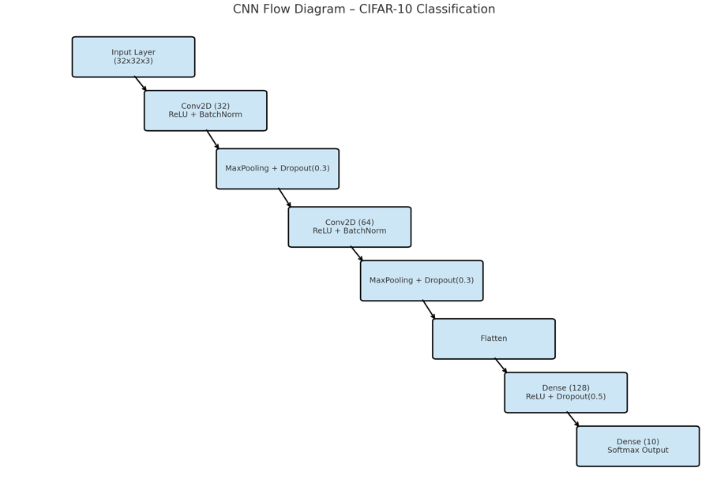
6. Neural Network Strategy
Input Layer: Input Shape 32 x 32 x 3
Represents RGB images (3 colour channels)
Passes pixel data directly into the network
Convolutional Layer: Conv2D: 32 filters)
Extracts basic spatial features like edges and textures
Uses ReLU activation for non-linearity
BatchNormalisation: Normalises output from the previous Conv2D layer
Stabilises training and accelerates convergence
MaxPooling Layer 1: Reduces the spatial dimensions by 2x2 pixels
It reduces dimensions by retaining key patterns
Adds translation invariance, so small shifts in the image do not affect results
Convolutional Layer 2: Conv2D: 64 filters
Learns more complex patterns, building on earlier features
Dropout (Rate: 0.3): Randomly deactivates 30% of neurons
Prevents overfitting by adding randomness during training
Flatten Layer: Converts 3D feature maps to a 1D feature vector
Prepares data for the fully connected (Dense) layers
Dense Layer (128 neurons): Fully connected layer that performs final feature combination
Applies weight decay (L2 regularization) and ReLU activation
L2 regularization prevents the model from relying heavily on any single neuron and reduces the risk of overfitting
Dropout (Rate: 0.5): Randomly disables 50% of neurons
Maintain the model robust and avoid over-reliance
Output Layer (Dense + Softmax): Dense layer with 10 neurons (one per CIFAR-10 class)
Softmax activation outputs probability between [0, 1] for each class
All class probabilities sum to 1 and the class with the highest probability is selected as predicted class
9

Slide 12
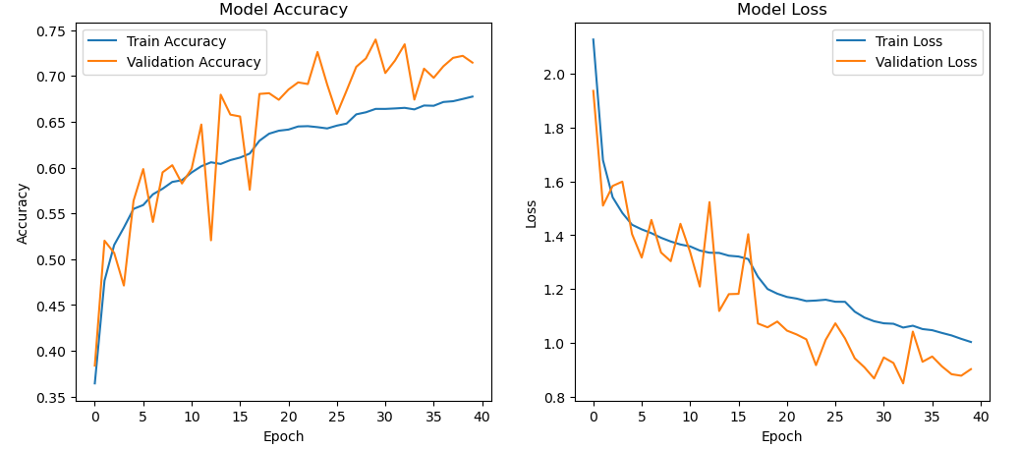
7. Results Analysis - Model Accuracy and Model Loss
Model Accuracy and Loss Analysis
Steady Accuracy Improvement:
Both training and validation accuracy improve consistently over epochs
Validation accuracy slightly outperforms training accuracy, indicating good generalization
No Overfitting Observed:
Validation accuracy does not degrade over time, which is a common symptom of overfitting
Model maintains performance consistency on unseen data
Loss Reduction Across Epochs:
Both training and validation loss show a clear downward trend
The model is learning effectively, minimizing error on both training and validation sets
Weak Fluctuations in Validation Curves:
variations in validation loss/accuracy reflect natural variation in batches. No signs of training instability.
Validation Loss Below Training Loss:
Indicates that dropout and regularization are successfully reducing overfitting
The validation data may be easier to predict than training batches due to data augmentation
Conclusion:
The model exhibits healthy learning behavior with balanced accuracy and loss metrics
The training strategy (e.g., dropout, batch normalization, early stopping) appears well-tuned
10

Slide 13
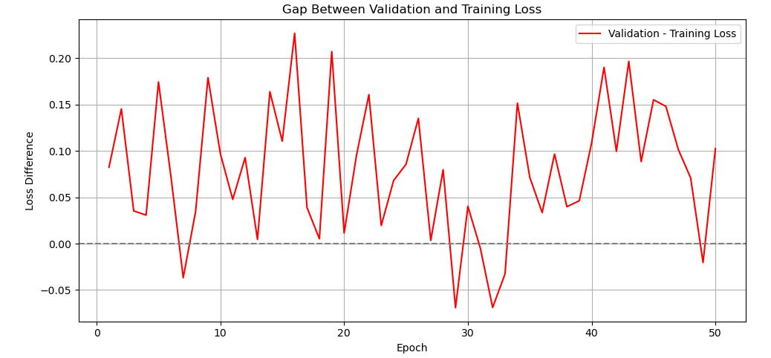
7. Results Analysis – Validation and Training Loss gap analysis
Analysis of Loss Difference Between Validation and Training Sets: Loss Gap=Validation Loss−Training Loss
Visualises the difference between validation and training loss across 50 epochs
Assessment of the model generalization and detection of overfitting or of underfitting
Key Observations:
Most of the data points lie above the zero line, indicating that validation loss is generally higher than training loss—expected behavior as the model is trained directly on the training set. No model experience with the validation set
Instances of dips below zero indicate where validation loss is lower, this may be due to: simple examples in the validation set and the impact of the data augmentation on the training data
A small and consistent gap indicates a healthy generalization ability for the model
Interpretation:
The loss gap fluctuates moderately but remains within a narrow range (mostly under 0.2), indicating: No severe overfitting and good alignment between training and validation performance
Consistent gap suggests the model maintains a reasonable generalization ability
Conclusion:
The training strategy, including regularization and data augmentation, appears effective in mitigating overfitting
The model learns robust features without ‘memorizing’ training data
11

Slide 14
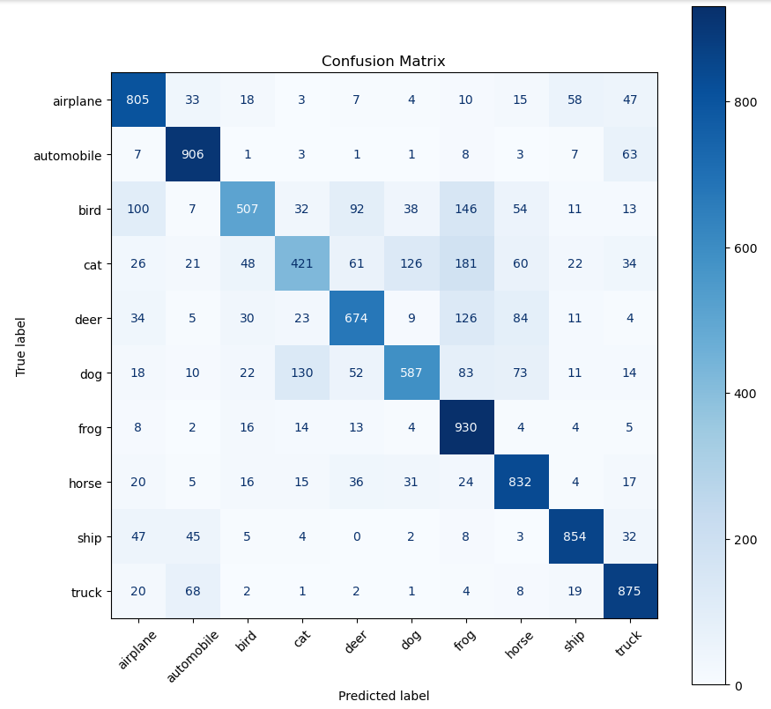
7. Results Analysis – Confusion Matrix
Confusion Matrix Analysis
Diagonal values (True Positives): they represent correctly classified instances.
High values along the diagonal indicate strong model performance for those classes. Example:
Airplane: 805 correct (out of 1,000) test images
Frog: 930 correct – highest classification accuracy
Off-diagonal values (Misclassifications) show where the model confuses one class with another. Example:
Birds are often misclassified as cats (32), dogs (92), and deer (38)
Cats are often mistaken for dogs (126) and frogs (181), indicating similar visual features
High-performing classes: Automobile, Frog, Truck, and Ship show very high accuracy (900+ correct predictions)
Confused class pairs: Cat vs. Dog and Bird vs. Frog are confusion pairs, likely due to overlapping shapes or textures in CIFAR-10 images
Balanced performance:
The model performs well across most classes with reasonably distributed accuracy, with no extreme class imbalance or collapse
Color bar helps visualize prediction density:
Darker shades = higher values (more correct predictions), lighter shades = fewer correct predictions or misclassifications.
12
Notes:
Chi-square test

Slide 15
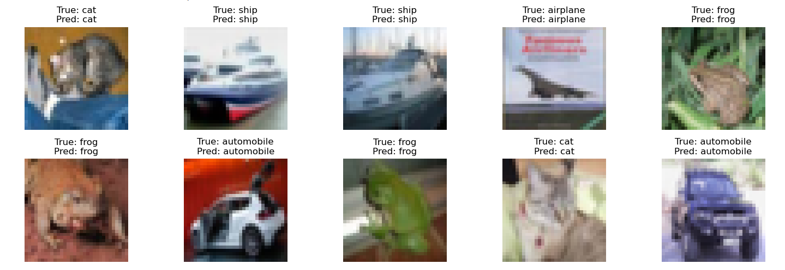
7. Results Analysis - Model Predictions – Visual Examples
The Correct Predictions is a showcase of the model’s competence
Each displayed image illustrates successful classification, demonstrating that the CNN can accurately learn and identify key visual patterns across object classes
Diverse Class Representation:
Samples include categories like cat, ship, airplane, frog, and automobile, show that the model handles varied textures, colors, and shapes effectively
Visual Confirmation of Class Discrimination:
Correctly predicted examples (e.g., Cat predicted as Cat, Automobile predicted as Automobile) validate the model’s ability to extract and learn distinctive features for each class
Supports Confidence in Generalization:
The samples reflect the model's strength not only in training but also in applying learned knowledge to unseen data
Pixel Clarity and Size:
Albeit the small image resolution (32x32), the model successfully distinguishes the objects' identity
13

Slide 16
8. Reflections and Lessons Learned
Good Strong Generalization Achieved:
The CNN maintained consistent validation performance, with no signs of overfitting, indicating effective learning and good model generalization
Data Augmentation Boosted Robustness:
Real-time data augmentation exposed the model to diverse perspectives, supporting better generalization and adaptability
ReLU Activation Maintained Healthy Learning:
The ReLU activation function showed stable activation behavior, not displaying dead neurons and exhibiting continuous learning
Balanced Class Performance:
Confusion matrix results demonstrated reasonable accuracy across all 10 CIFAR-10 categories
Effective Regularization Strategy:
Dropout and L2 regularization successfully prevented overfitting while maintaining model expressiveness
Stable Loss and Accuracy Trends:
Training and validation curves indicated stable convergence, with minimal divergence, validating the training strategy
Practical Use of Callbacks:
EarlyStopping and ReduceLROnPlateau callbacks optimised training time and performance without manual tuning
Next Steps:
Incorporate GlobalAveragePooling:
Replace Flatten() with GlobalAveragePooling2D() to further reduce overfitting and parameter count
Explore Hyperparameter Optimisation:
Use automated tools (e.g., Grid Search, Bayesian Optimization) to fine-tune batch size, learning rates, dropout rates, etc.
Enhance Explainability:
Integrate model interpretation techniques (e.g., Grad-CAM) to visualize which features influence predictions
Apply to Real-World Datasets:
Extend the CNN to more complex, real-world datasets (e.g., CIFAR-100 to test its scalability
14

Slide 17
9. References and Python Code
List of References
Krizhevsky, A., Nair, V. and Hinton, G. (2009) CIFAR-10. Available at: https://www.cs.toronto.edu/~kriz/cifar.html (Accessed: 2 April 2025).
Kingma, D.P. and Ba, J. (2015) ‘Adam: A Method for Stochastic Optimization’. Available at: https://arxiv.org/abs/1412.6980 (Accessed: 2 April 2025).
Jupyter Notebook Python Code Used
Link to GoogleColab from my ePortfolio
https://colab.research.google.com/github/spike2025-art/eportfolio-uoe/blob/main/project_improvement_3.ipynb
15

